Slide 1
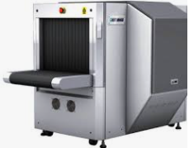
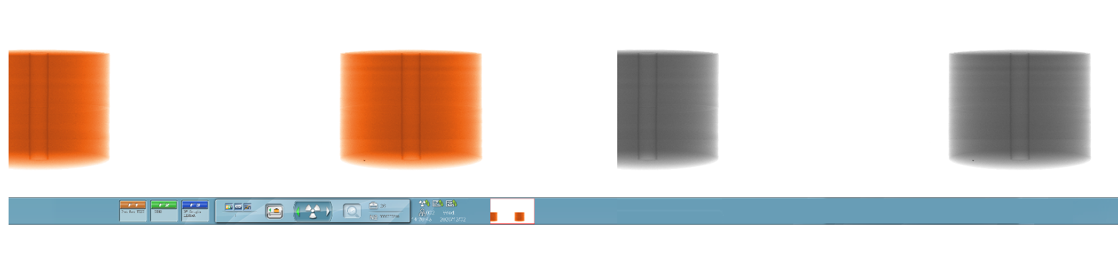
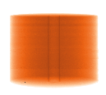
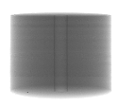
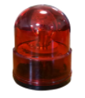
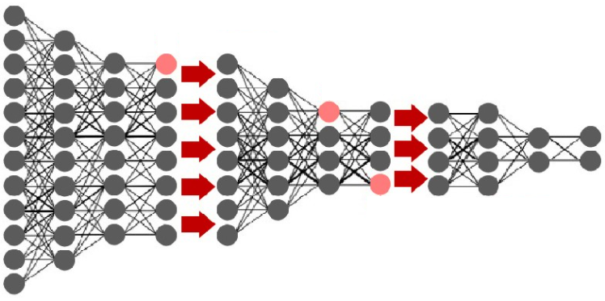
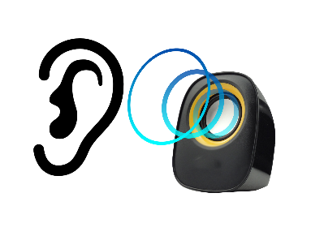
X-RAY SCANNER
RAW-DATA
지능형
이물질
검출
안내
시스템
STEP 1 Visually inspect
Detecting Foreign matter
Warning
Light
(siren)
Inspect Area
Display Blue ROI
Back-Data
Voice
Guide
STEP 2 Tiny inspect
Goods
Foreign Matters
Detecting by Machine Learning

